Slide 1
Indian Premier Leaque
Cricket Sport Center | 2023
Our IPL prediction model has been trained on historical data and is capable of making accurate predictions about which team is likely to win match.
Presentation by: Deepender Singh

Slide 2
Objective
The objective of our study is to predict the win probability of teams in each match at the end of every over for the 2023 IPL season.
We plan to use historical data from IPL matches played between 2008 to 2019 to train our model.
Our aim is to develop an accurate and reliable prediction model that can help cricket enthusiasts make informed decisions about the likely outcome of each match.

Slide 3
Table Of Contents
Introduction
Team wise Analysis
Player wise Analysis
Run wise Analysis
Feature Engineering
Model
Applying results through Web Application

Slide 4
INTRODUCTION
Cricket Sport Center | 2023
INTRODUCTION
The Indian Premier League (IPL) is a professional Twenty20 cricket league in India, which was established in 2008 by the Board of Control for Cricket in India (BCCI). It is played annually during the months of March to May and features eight teams representing different cities in India. The IPL has become one of the most popular and lucrative cricket leagues in the world, with top international players participating alongside local talent. The league has also been a platform for young and upcoming cricketers to showcase their skills and earn recognition. The IPL has been known for its high-scoring matches, close finishes, and enthusiastic crowds, making it a highly entertaining and exciting tournament for cricket fans around the world.

Slide 5
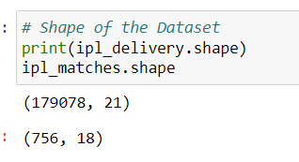
Data Comprise Of
Data
List of Upcoming matches team
From 2008 to 2019, All IPL matches ball by ball.
Web Scrapping

Slide 6
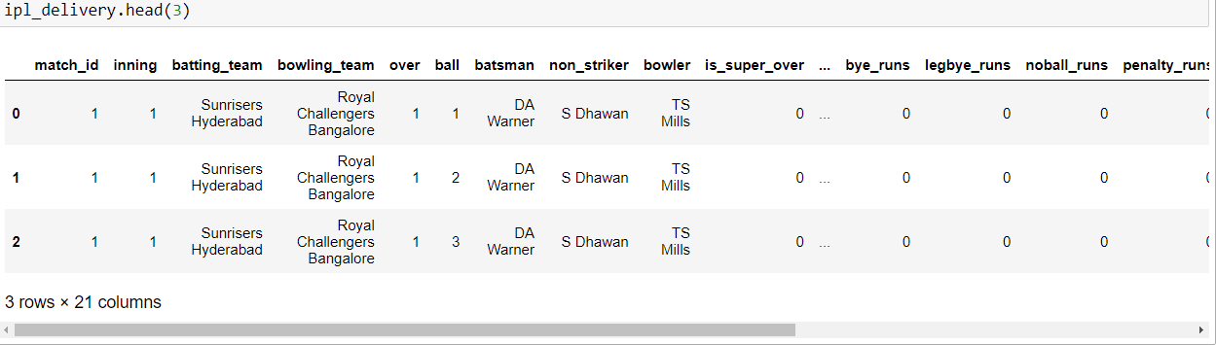
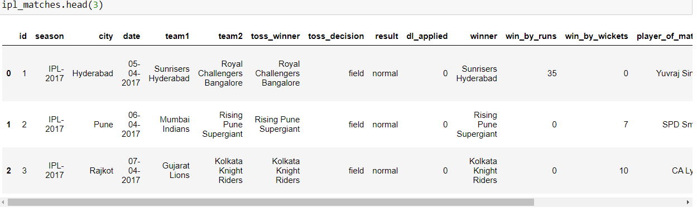
Snapshot of Data
BALL BY BALL DATASET
Matches Data

Slide 7
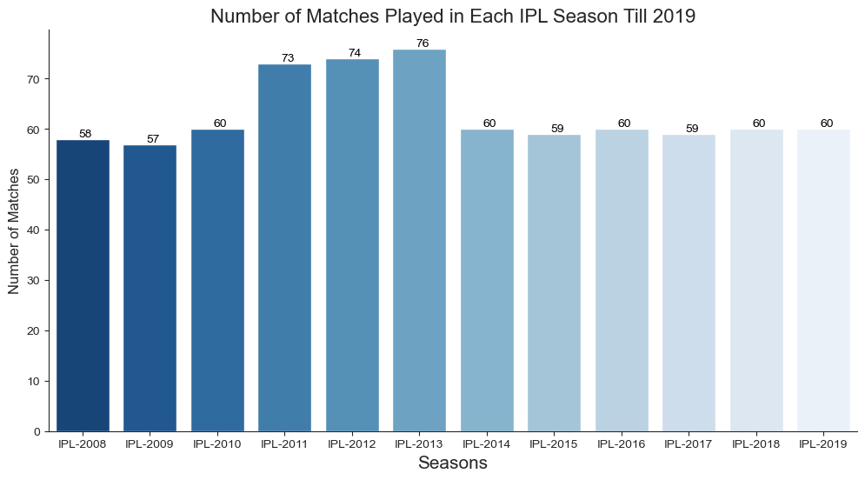
Season Data Throughout The Years

Slide 8
Analysis on the Data

Slide 9
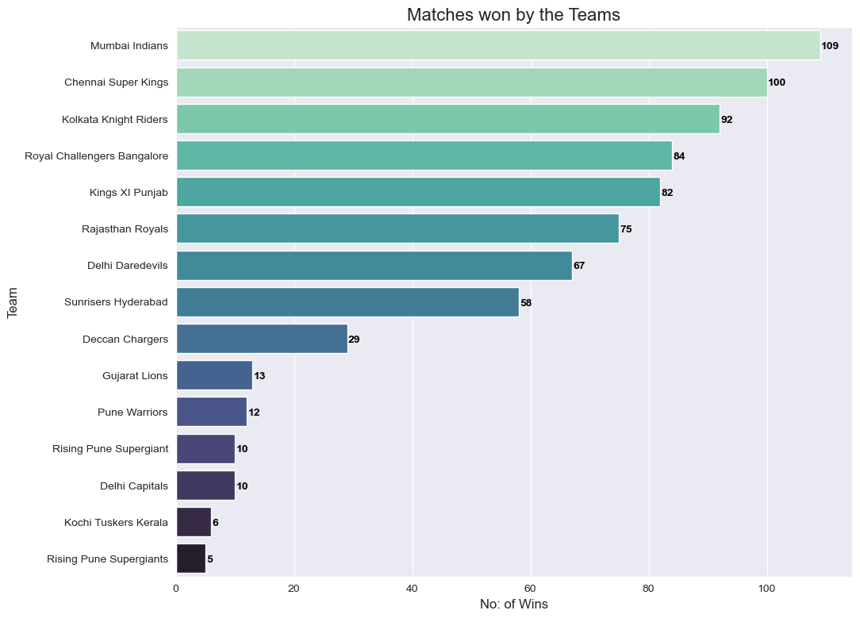
Won Matches

Slide 10
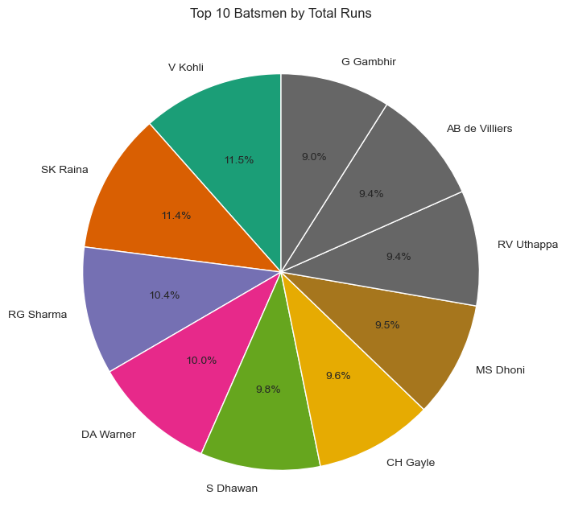
Best Batsmen of the Era

Slide 11
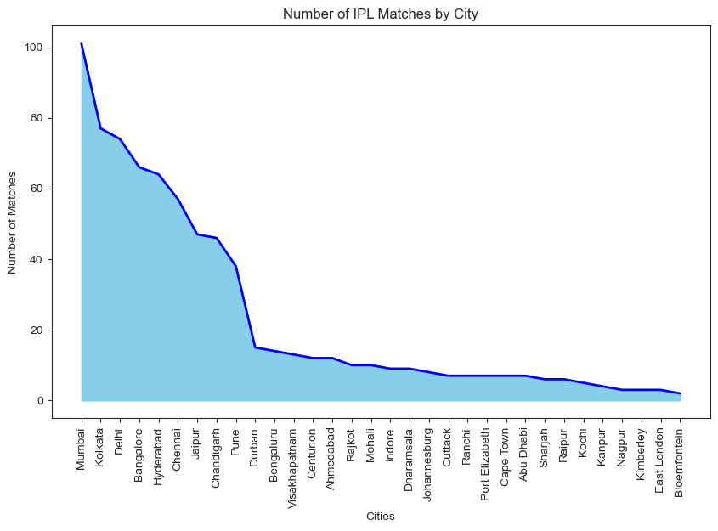
By City

Slide 12
IPL Matches

Slide 13
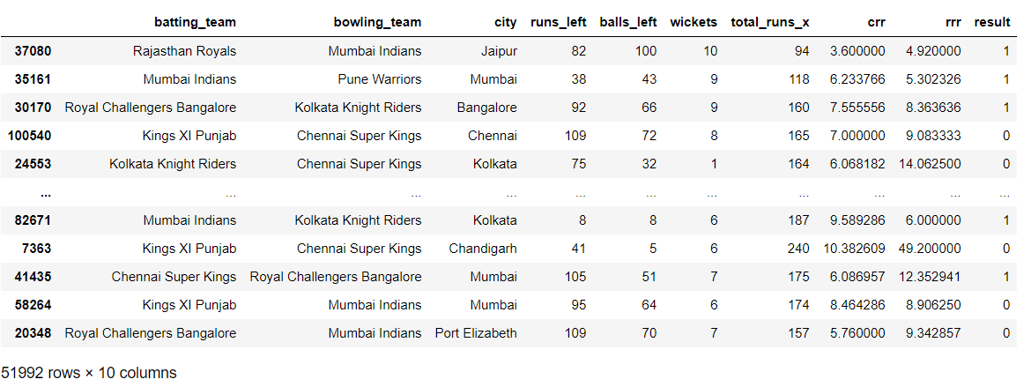
Extraction of the features:

Slide 14

Pre-processing & Model:
The data pre-processing step uses a Column Transformer object to transform the categorical features in the data into numerical features that can be used in a machine learning model. The One Hot Encoder function is used to perform one-hot encoding on the categorical features 'batting_team', 'bowling_team', and 'city’.
The model training/prediction step uses a Gradient Boosting Classifier object, which is a machine learning algorithm that learns to make predictions based on the transformed features.
The accuracy of the model predictions is calculated using the accuracy score function from scikit-learn. In
this case, the accuracy of the model predictions was 0.839, which means that the model was able to correctly
predict the class of 83.9% of the samples in the test data.

Slide 15
OUR TEACHERS
Jan Molendijk
Erin Berardi
Simão Lopes
Lead Teacher
Teaching Assistants
You can speak a bit about this person here

Slide 16

THANKS
THANKS
Do you have any questions?

Slide 17
ALTERNATIVE RESOURCES
Article Resource:
https://ictactjournals.in/paper/IJSC_Vol_11_Iss_1_Paper_2_2199_2204.pdf

